Slide 1




ISSP
INT’L SOCIETY for SYSTEMS PATHOLOGY: CURRENT STATUS
IS SS
20 17
Len Troncale, Past President, ISSS, 1990
Prof. Emeritus & Past Chair, Biology Dept., College of Science, Lecturer, M.S. in S.E., College of Engineering, Calif. State Polytechnic Univ., Pomona
lrtroncale@cpp.edu

Slide 2
CONTENTS/OUTLINE I.
Systems Pathology Manifesto
Statement of Expectations/Vision; called for by ISSS members for years
International Business Office
Place; Grants; Funding; Staffing
Applications to California Secretary of State
Pass out Current By-Laws (8 pages)
Pass out Current Articles of Incorporation (4 pages)
ISSP Membership Recruitment Plans
Types of Memberships; Pass out membership application form
Letters of Invitation to All Domains
Anticipated Services to Members
Call to Join and Participate as Founding Members to 2020

Slide 3
SYSTEMS PATHOLOGY MANIFESTO

Slide 4
Manifesto for top-down Systems Pathology?
Do we even need a “manifesto?” (Singers)
Manifesto’s have a mixed reputation
Marxism-Communism; Terrorists; fascism; anarchists, but also Dec. of Ind.; MLKing’s “I have a dream;”
Not to conflate major and minor movements; still a change of course needs a foundation statement
E.g. note influence of recent Manifesto for Agile Software Engineering
What does a “manifesto” do?
(L) etymology revealing: manifestum meant “clear or conspicuous” so should accomplish – make clear what it is and bring it to the attention of as many as possible; declaration of tenets and intentions
Systems Pathology Manifesto (handout) NOT one person, facilitate → consensus
Modeled after Agile Software Dev’t Manifesto: Completed at a Utah ski resort Feb, 2001 Agile Alliance
Main Points ToDate: Cite Savings; Defining features; Learn from Medicine; Cite History; Cite Sources; Caveats?
Signatories: Founding Members (after first Founding year, roughly Jan 2017-2020);

Slide 5
ISSP INTERNATIONAL BUSINESS OFFICE

Slide 6
Initiate an Int’l Society for Systems Pathology I.
Steps to Official Incorporation
Secure Office Space (DONE)
Share office with Wilson Foundation Trust, So. Cal. Office, Harrison, Claremont, Ca.; two houses from 8-campus Claremont Colleges
Secure Core Staffing (Partially Done)
Univ. student jobs; have already been awarded two Foundation grants to support salaries
My personal leftover overhead funds + Wilson Trust $2,000 + INCOSE Foundation $1,500 (2 awards)
I will volunteer free time as initial Managing Director (with goal of identifying young interested professionals of taking over quickly for long-term longevity and continuity)
Bank Account
Set up as named Bank of America account; currently $1,400; after incorporation papers approved
Need funds to hire student to publicize, keep records, start products, run conf.; files, archives, etc.
Obtain official IRS 501(c)3 Status (non-profit incorporation)
Application requires Articles of Incorporation, By-Laws, resident state review, obtain federal tax ID # (IRS Form SS-4); filing IRS Form 1023; annual filings; will be sent upon my return to U.S.
Begin ALL of the Membership, Conference, Publications, and Associated Enterprises

Slide 7
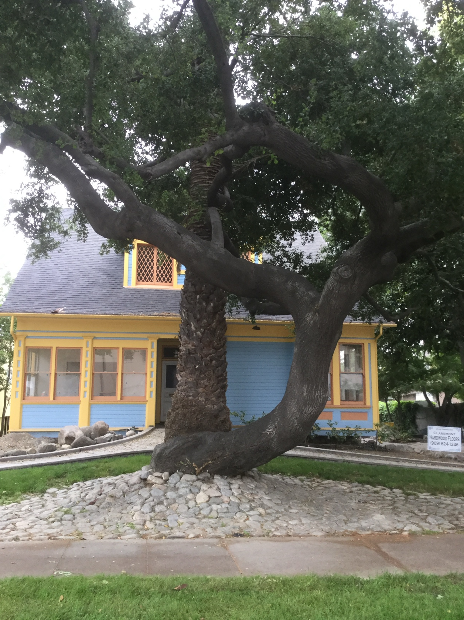
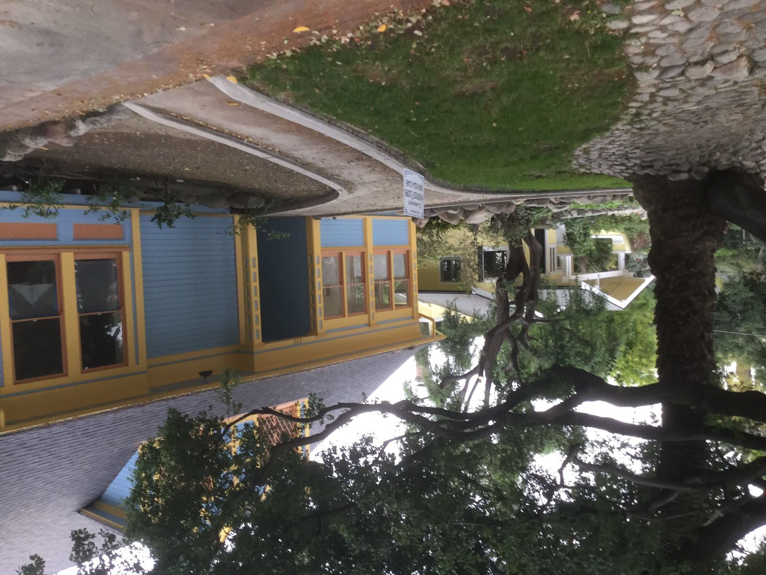
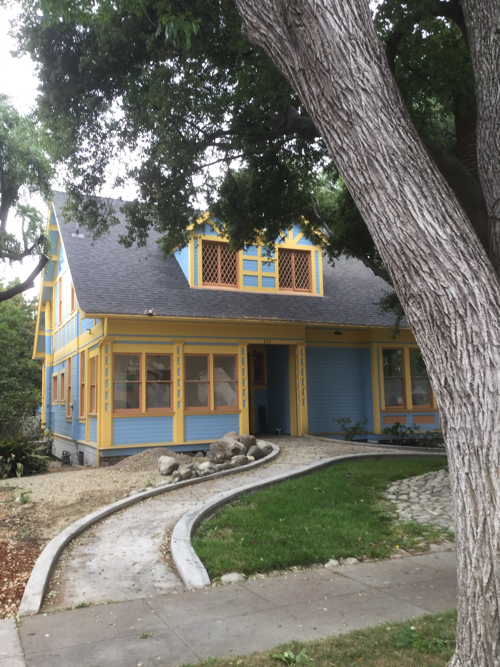

Slide 8
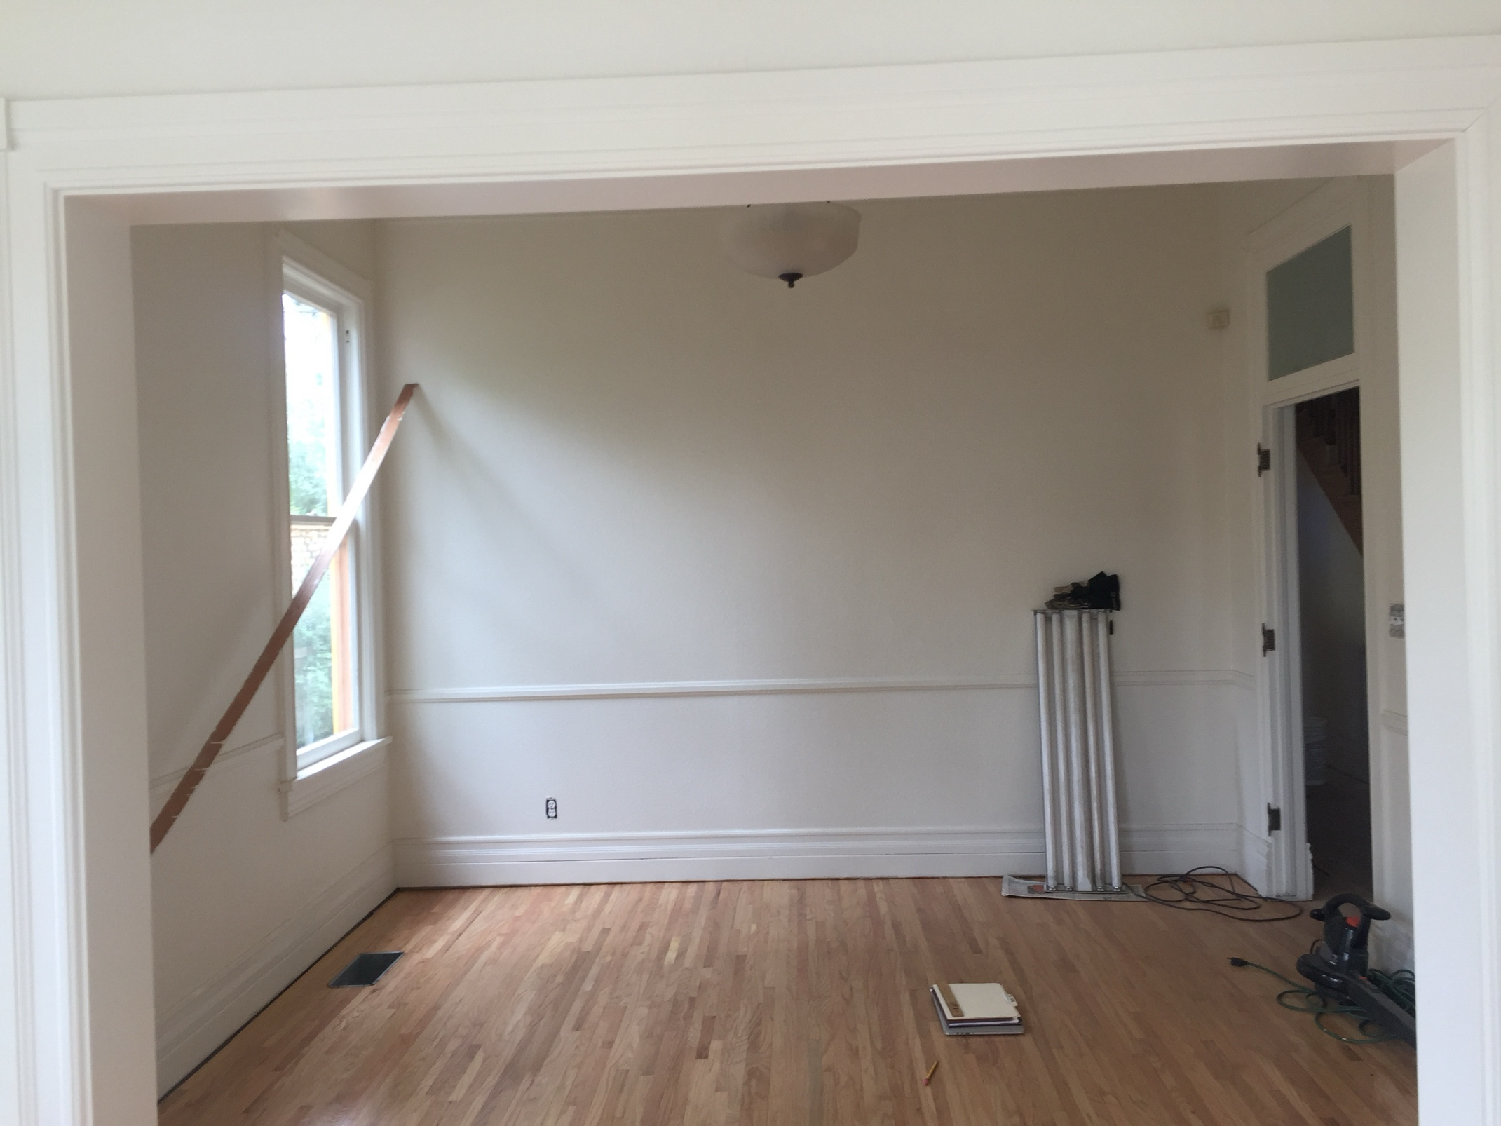
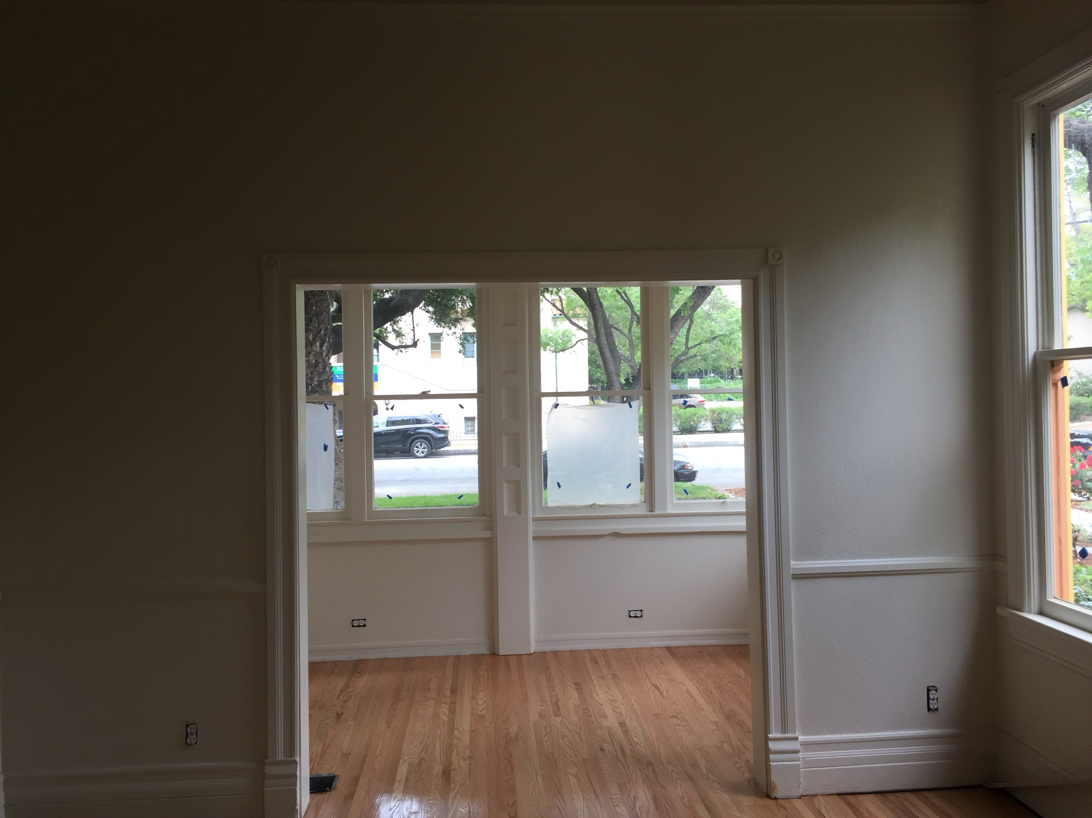

Slide 9
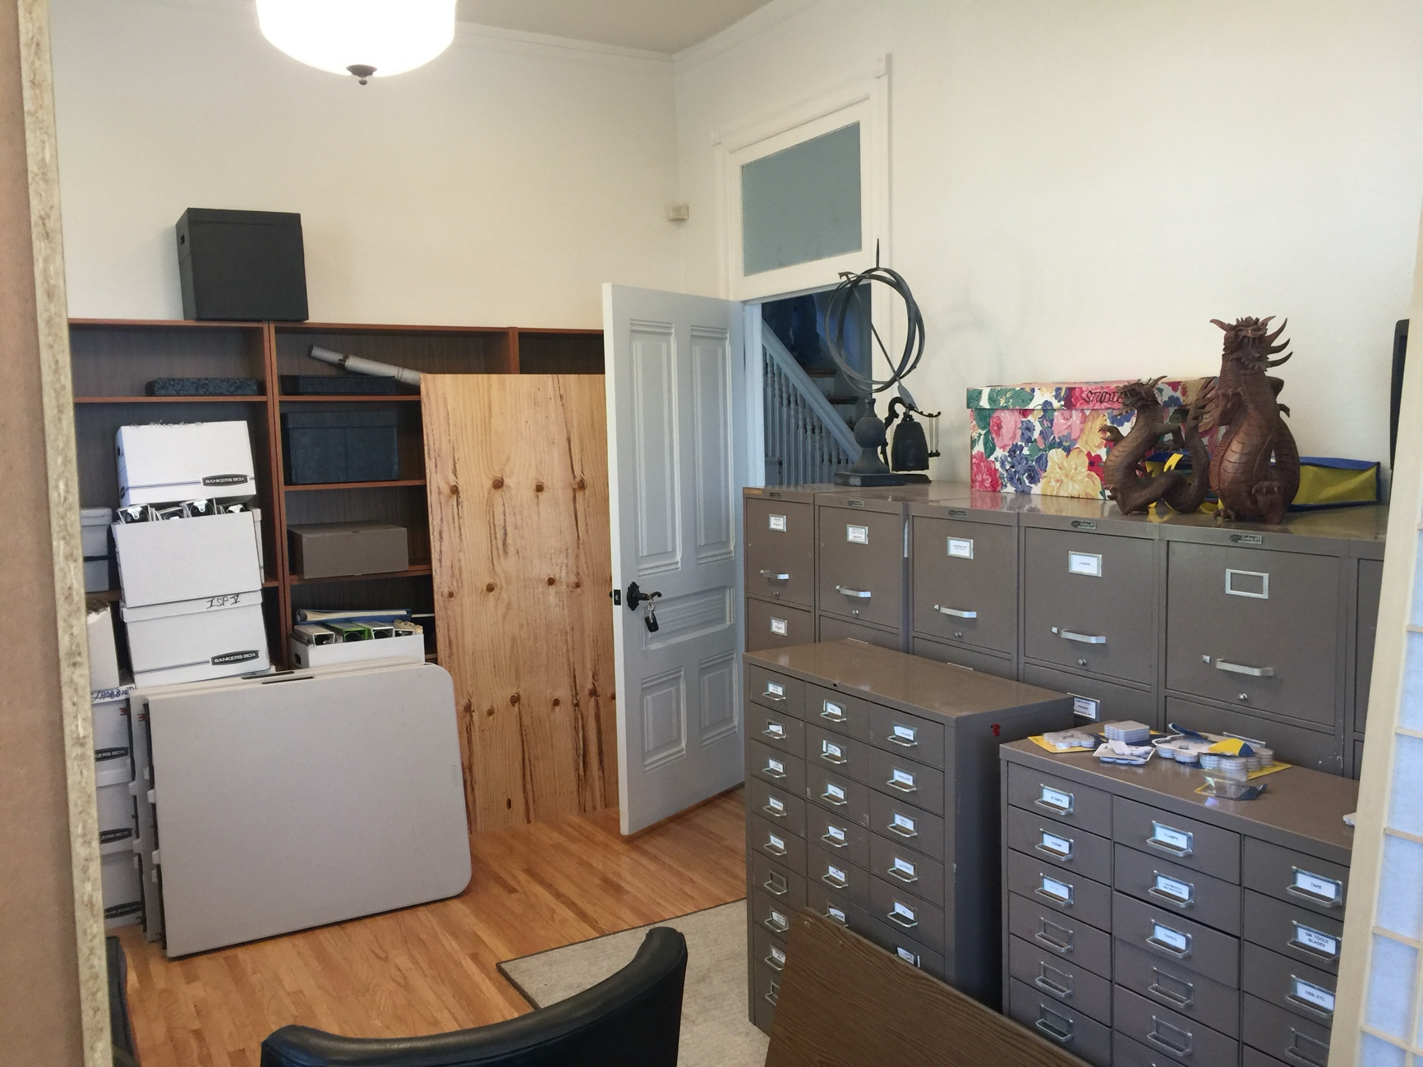
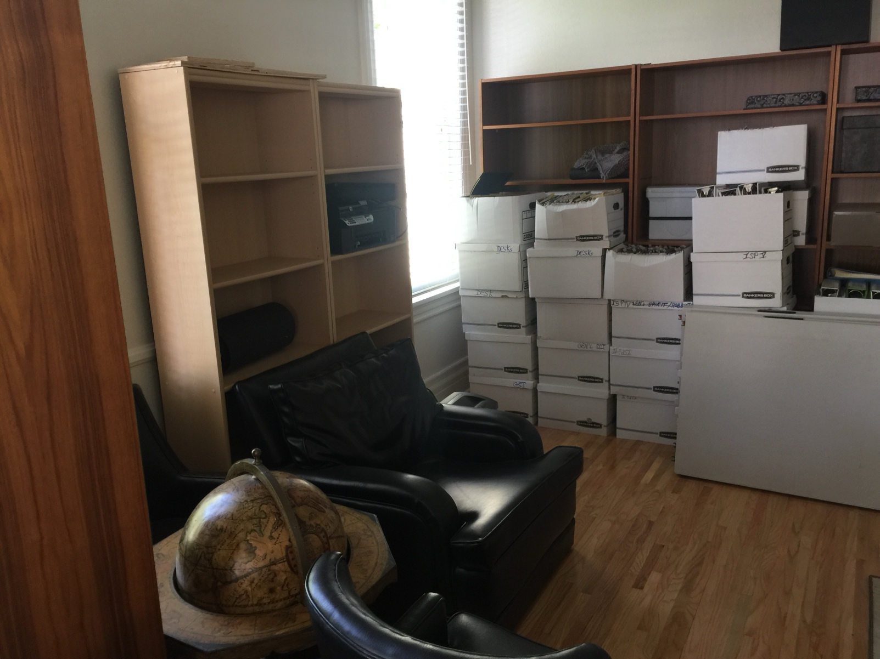
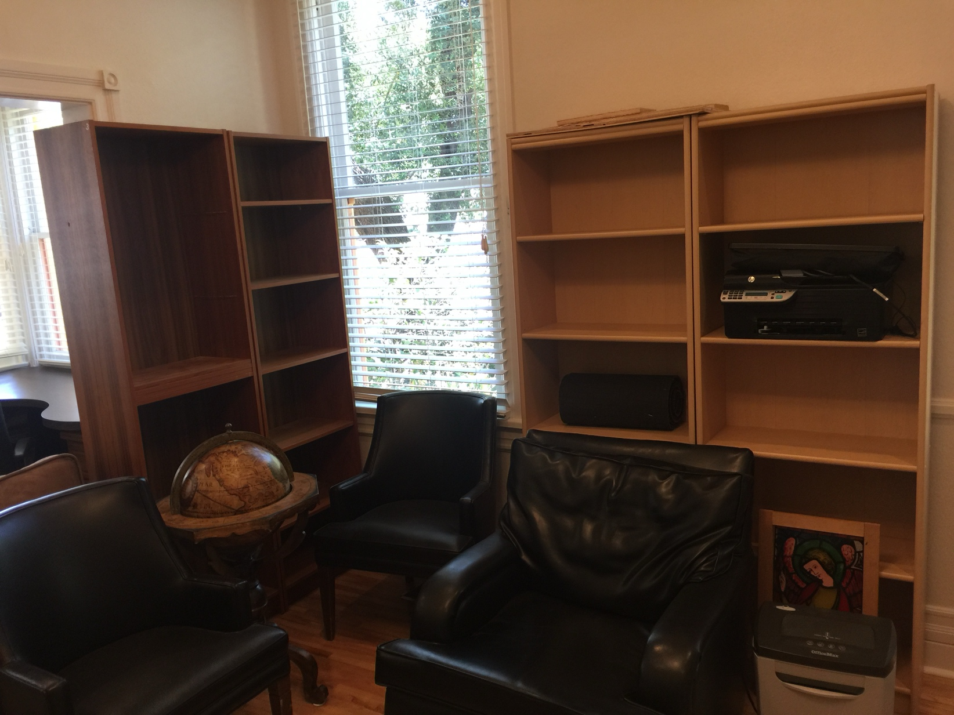

Slide 10
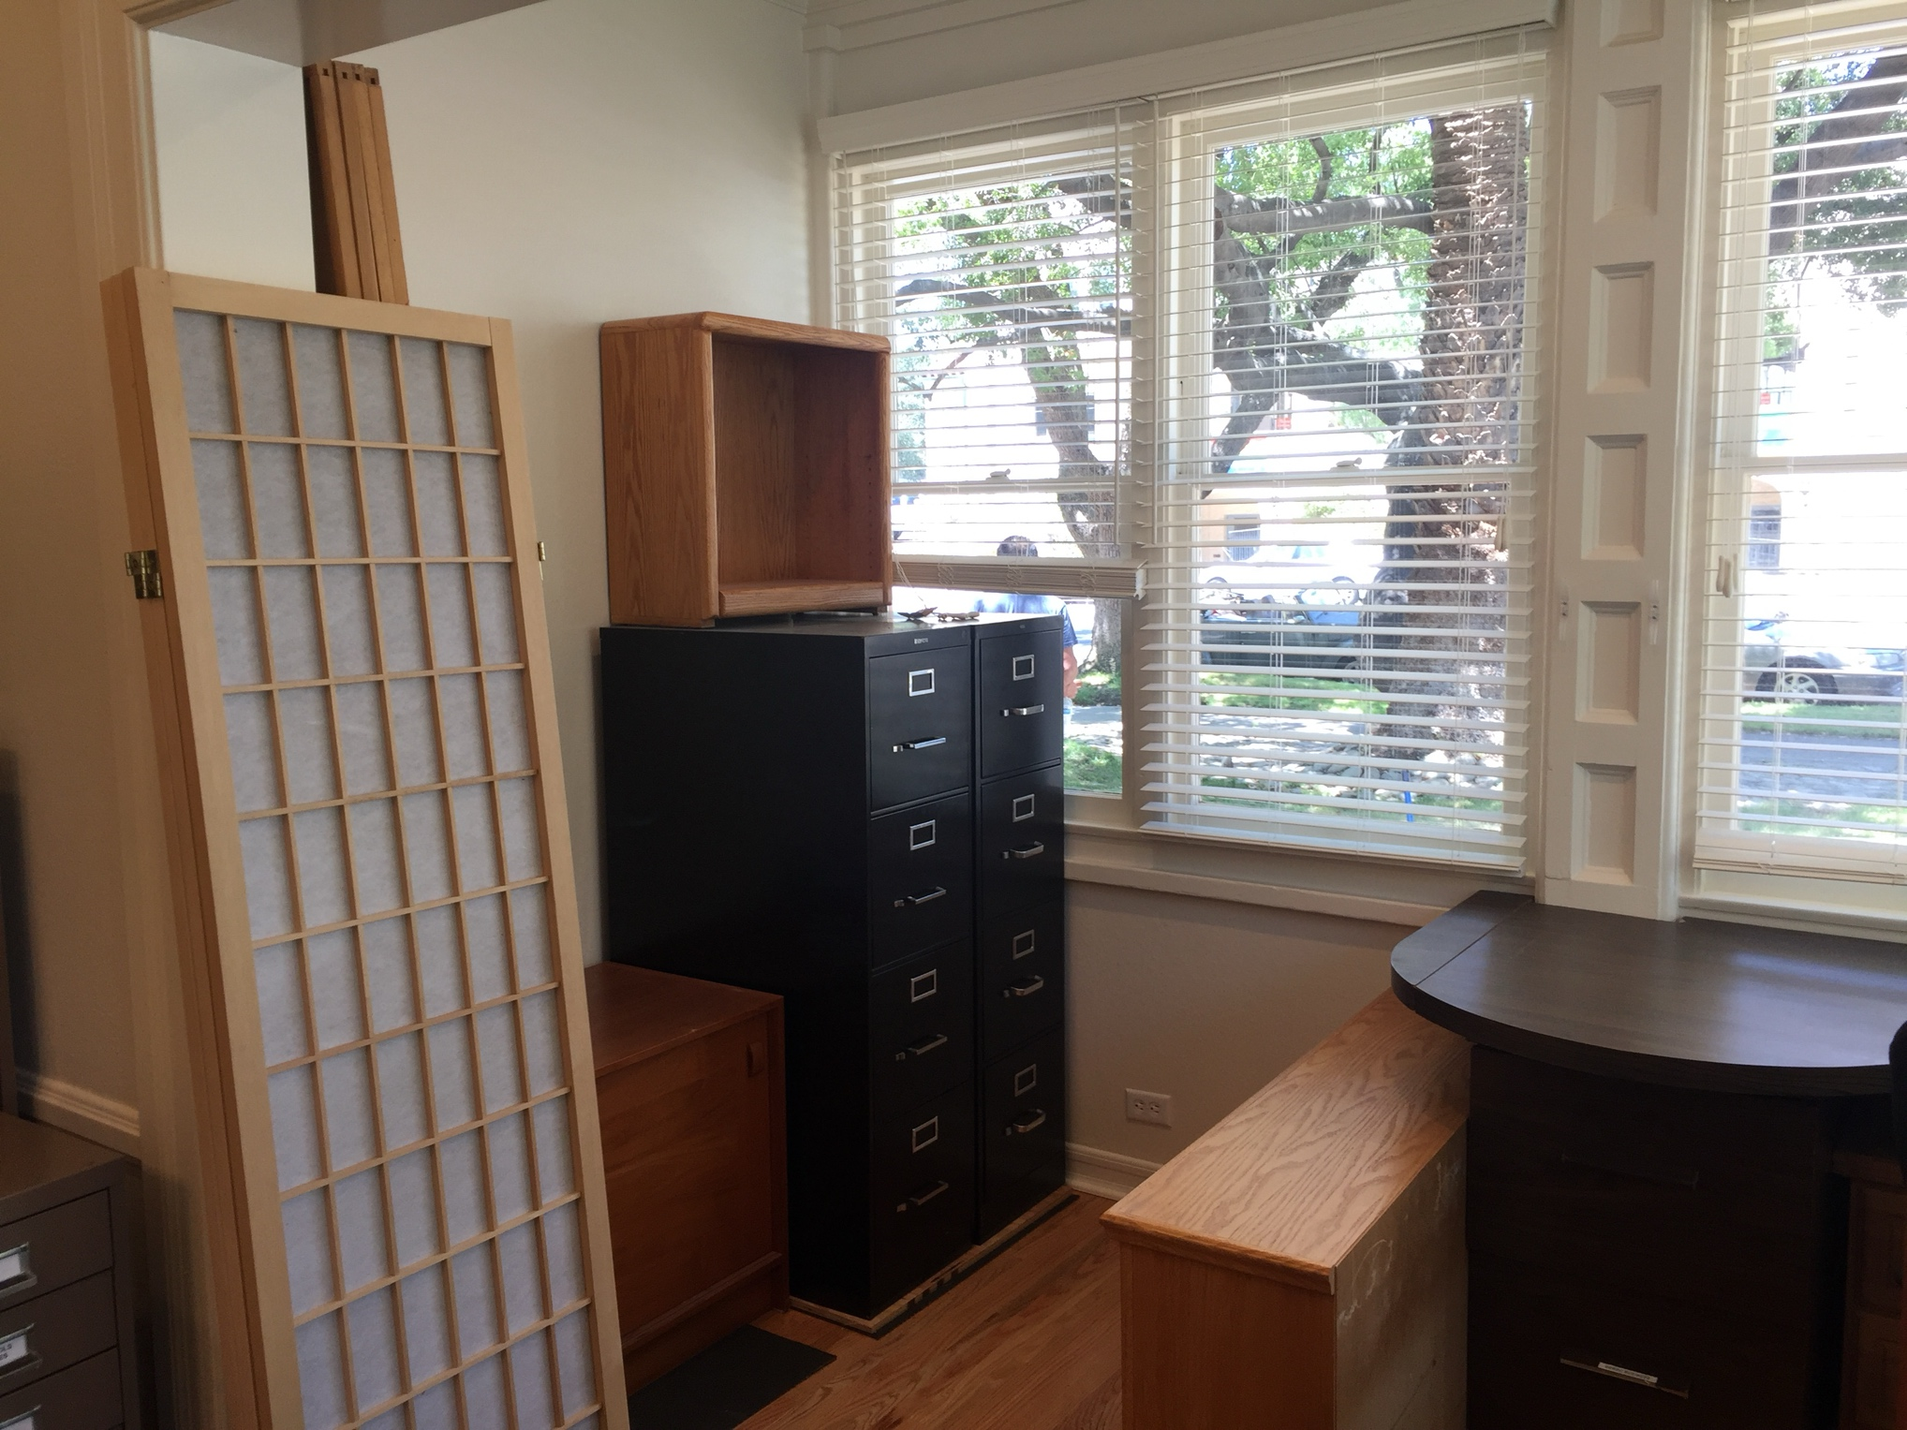
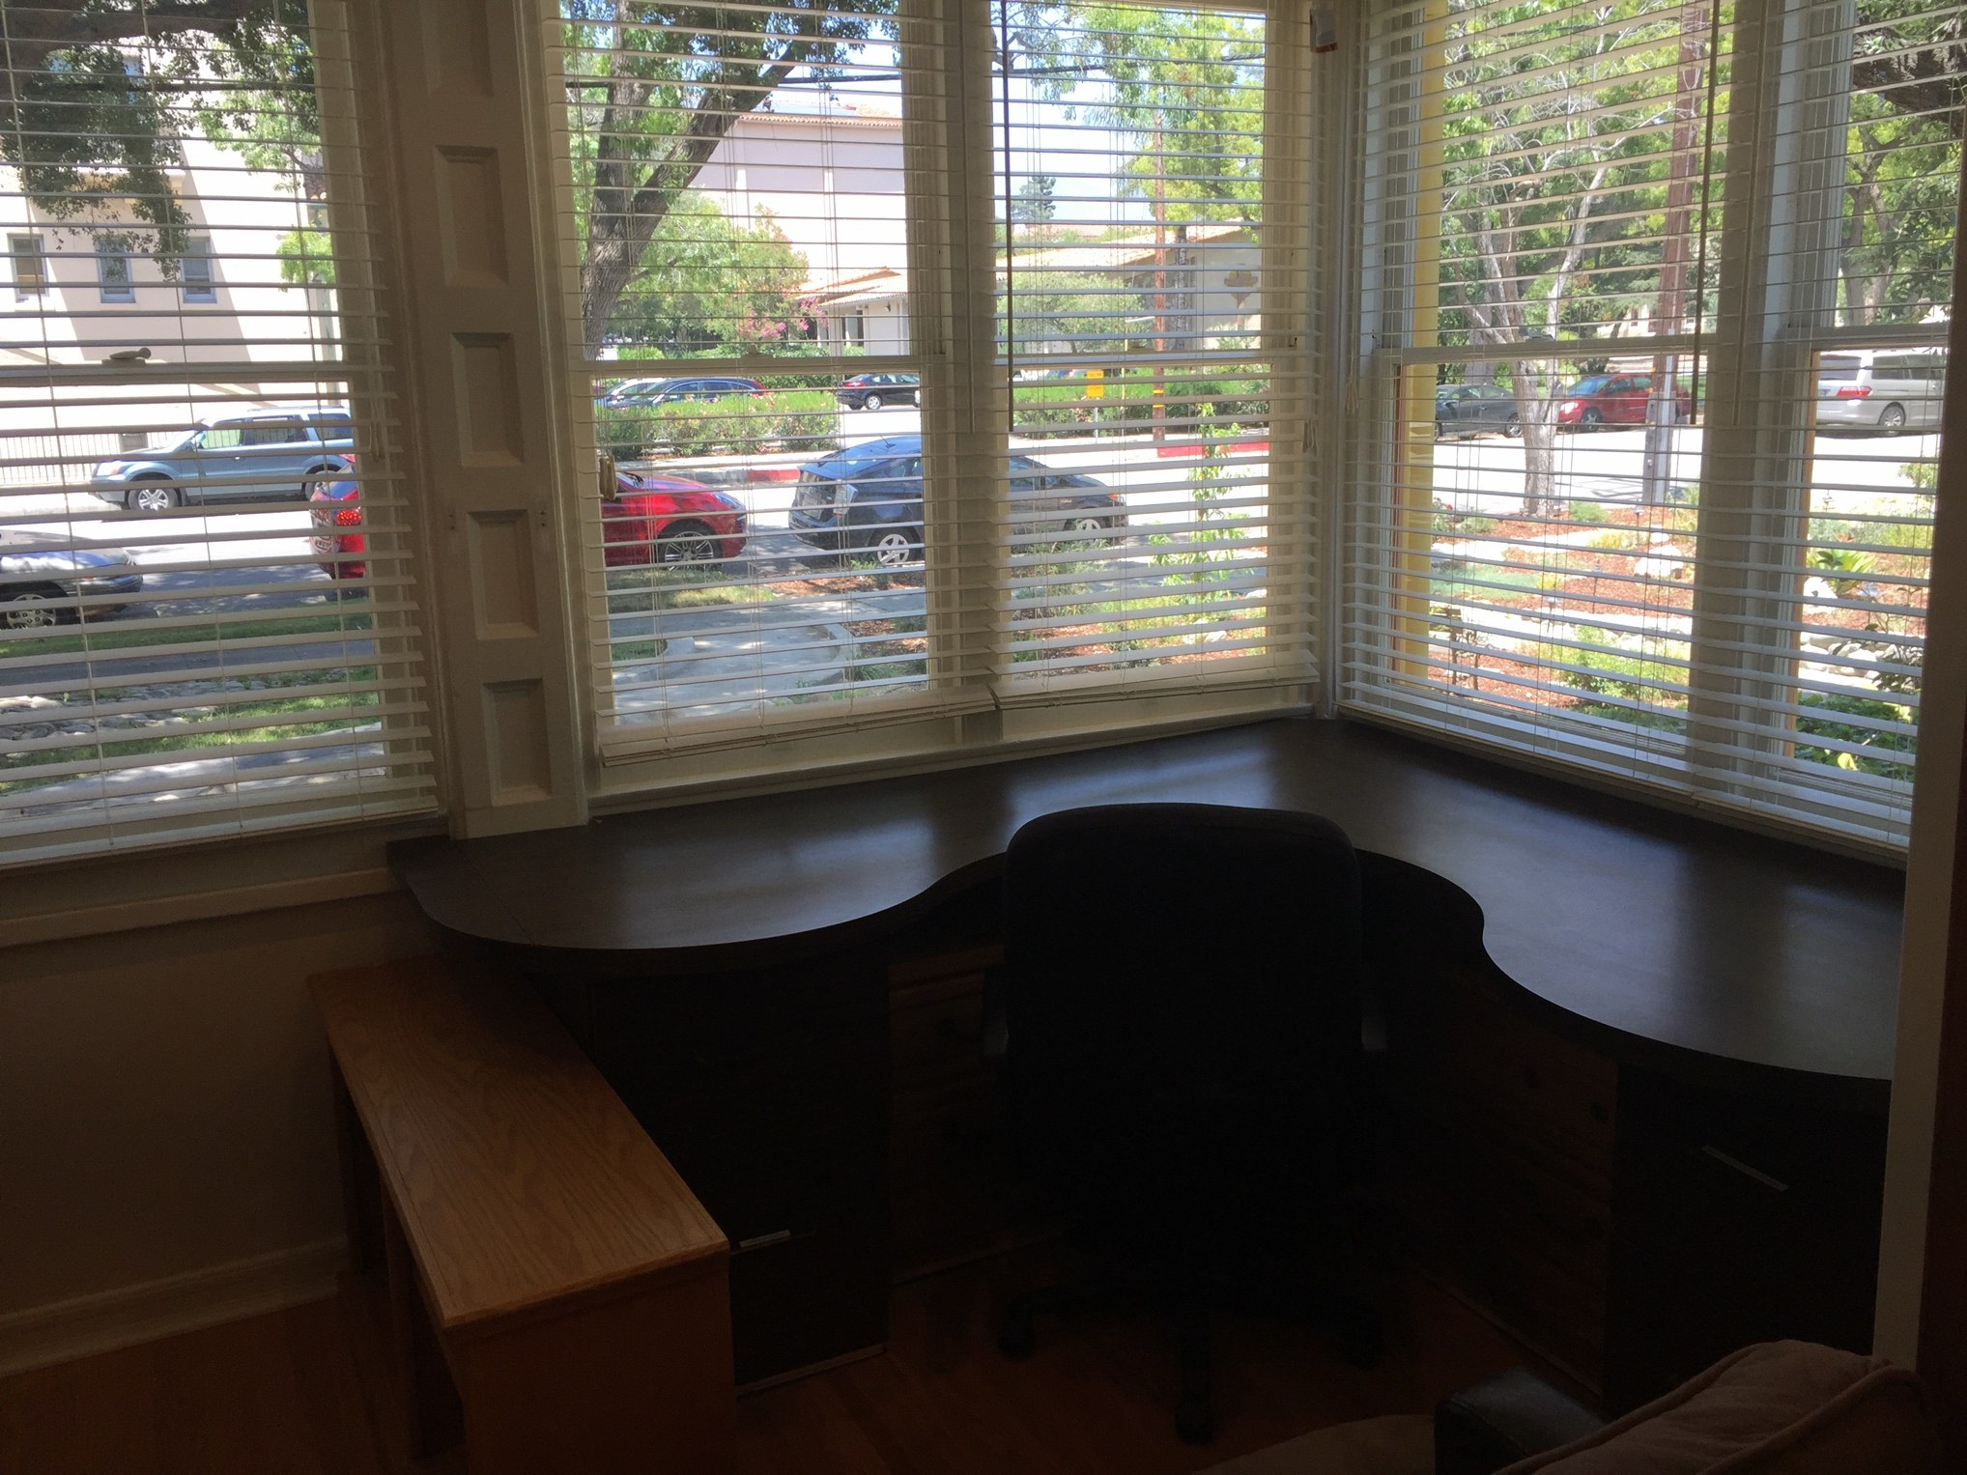

Slide 11
APPLICATIONS TO CA SEC’T OF STATE

Slide 12
Initiate an Int’l Society for Systems Pathology II.
Needed documents as Handouts for Review and Improvement?
In all of these cases I composed rough drafts to handout for early Founding members to edit, revise, discuss, improve and evaluate previous to voting approval
To get things moving at this meeting, ISSS, Vienna’17 and already presented at INCOSE-IW’17 in Jan
Improve and Approve Acts of Organization? (Done)
Improve and Approve By-Laws (Done)
Managing Director (Initiator) Letter Appointing first Board Directors (10 appointed)
Compose Agenda & Hold First Board Meetings & Approve Minutes (3 already completed)
Compose Agenda & Hold First SysPath Development Meetings w Reports (2 completed)
Reserve Domain Names & Host for Websites (Done)
Organize and Implement Main Website for ISSP (Done)
Petition California Sec’y of State for Formal Name Search (pending)
Compose, Improve and Later Adopt Manifesto? (This work begins at this meeting)
Collect & Receipt Initial Dues (14 members to date)
Formal Applications Completed, but not sent

Slide 13
MEMBERSHIP RECRUITMENT PLANS

Slide 14
Initiate an Int’l Society for Systems Pathology III.
First on Action Agenda: Why should anyone join ISSP? What Benefits??
Imagine a dozen benefits as follows……….
Publication discounts;
Conference attendance discounts (both for regional, national, international Annual & Workshop)
New places to publish (in books, Yearbooks, Journal)
New places for talks/presentations/workshops/
Early knowledge of advances;
New opportunities for collaboration (with dozen Alliance organizations)
Another professional citation;
Research stimulus in new research areas with new research ideas;
Thrill of starting a new movement;
Free Use of ISSP Relational Data Base
Use of ISSP Bibliographies
Service to society & industry; Chance to reduce failure & waste; contribute to saving natural systems;
New Institutions for consulting; job applications;
Uses of ISSS & ISSP Archives at New Business Office;
Can you think of any others???

Slide 15
Overview of 10 Domains to Solicit for Membership
Initiate an Int’l Society for Systems Pathology IV.
IS SS
20 17
GST and Systems Science Domain (systems theorists) ISSP began here
Systems Dynamics & System Thinking Domain (systems application workers)
Systems Engineering Domain
Other Engineering Domains
Systems Biology Domain
Conventional General Medical Pathology Domain
Workers in Sustainability Fields
Workers in Ecology and the Environment
Systems Design Domain
Systems Management Domain

Slide 16
Initiate an Int’l Society for Systems Pathology V.
Who would be Members?
Some ISSS, members & general pop’n of systems thinkers and systems scientists
There has been a S.I.G. on Systems Pathology (Special Integration Group) in ISSS for nearly a decade
Some INCOSE, IFSR, European Sys. Societies, NECSI, Sante Fe Institute, ISSB, AAAS
Current Founding Members (alpha list)
Heidi Davidz, Richard Emerson, Luke Friendshuh, Kristin Giammarco, Polinho Katina, Tom Marzolf, Curt McNamara, Jack Ring, Janet Singer, Michael Singer, Peter Tuddenham, Len Troncale, Jennifer Wilby
3 Pres. of other Int’l Societies; 7 systems engineers; 9 systems scientists; 4 modelers
Reaching out for Members (publicity campaign) Plans for Invitations to …
Professional Org’s (plus your suggestions)
Target Centers and Institutes focused on Systems: hundred’s in our files, listed on the Internet
Target Prof. Societies: Am. Soc. For Clinical Pathology; College of Am. Pathologists; U.S. and Canadian Academy of Pathology; Int’l Academy of Path; Calif. & Los Angeles Soc. of Pathology
Readers and authors of the wide range of “systems” books and journals (see SASSI below)
Word of Mouth & thru Presentations (up to you)

Slide 17
ANTICIPATED SERVICES TO MEMBERS

Slide 18
Planned ISSP Products and Services I.
Annual Systems Pathology Conference
Start as part of established annual conf. series, like ISSS (e.g. 61st in Vienna 2017)
As Fuzzy Set mathmeticians did in 70’s;
Annual Systems Pathology Workshops
Quarterly Systems Pathology Newsletter or Bulletin
Journal of Systems Pathology
Yearbook /or/ Annual Review of Systems Pathology
Adv. Vs. Disadv. of Self-Publishing; Profits to ISSP
Worldwide libraries will need to START their collections in SysPath; solid revenue stream
Requires appointment of Panel of Editors from each SysPath Domain; also attracts membership
Edited Introductory Volume
Like that for “Self-Organization;” or “Systems Mimicry;” Vision plus deep specifics in many Chapters
Introduces, announces new transdiscipline and thereby attracts membership also

Slide 19
Planned ISSP Products and Services II.
Systems Pathology Bibliography Manual
Systems Pathology Public, Open, Online Relational Data Base
Systems Pathology & Systems Science Reprint Archive
Supporter of SASSI? Same office
SASSI means Serial Abstracts for Systems Science, International
This will be a “for profit” business offering a digitized and/or hardcopy version to all Univ. Libraries
Some percentage of the profits will go to Professional Organizations like ISSS
SysPathBoK? Book of Knowledge or Operations Manual
Professional Alliances and Collaborations
Special Integration Groups
Like INCOSE WG’s but emphasis on specialized interest or subgroup with “synthesis” focus
Unique, New Cluster of Skills to Cite
Contribution to new Systems Application area; service to society/industry
Wider range of employment for SE’s & SS’s; “Is there a Systems Doctor in the house”

Slide 20
Expected ISSP Alliances & Collaboratories I.
International Society for the Systems Sciences (ISSS)
Systems Pathology SIG since 2001; several paper sessions as history
International Federation for Systems Research (IFSR)
ISSP Manager was one of the first IFSR Directors
International Council for Systems Engineering (INCOSE)
Initiated at INCOSE IW; one of the ongoing SSWG projects since 2010; interest of NSWG
IEEE Systems Segments
Sante Fe Institute or NECSI (as partners to PARCSI)
Have not measured or assessed their interest to date but did present a couple of papers and posters on Systems Pathology in past NECSI ICCS Conferences (Int’l Conf. on Complex Systems)
Most rigorous this author and his colleagues have ever attended on true systems science
Attended almost entirely by scientists from ALL of the natural sciences
Conventional Medical Pathology organizations
See slide #3 and more; first new Dept. at Harvard Medical School in 40 years was Systems Biology which we assume will have some who are interested
New Societies and Journal authors from Systems Biology, SynBio, Biomimicry

Slide 21
Expected ISSP Alliances & Collaboratories II.
Planned Foundational Organizations; shared office home with ISSP
ISISTEM (see next slides for detail)
Institute for Systems-Integrated Sciences,Technologies, Engineering, and Mathematics
As direct descendent of the 45-year old Institute for Advanced Systems Studies (IAS)
23 campus Fellowship in the California State University System modeled after IAS
Already met twice with the Vice Chancellor of the CSUC System for Cross-Campus Programs
Currently a faculty office on Cal Poly Pomona campus (impermanent?) 94-290; 909-869-2045 which could serve as initial organizing office for ISISTEM
fPARCSI (see next slides for detail)
Federation of Pacific Rim Complex Systems Institutes
The Pacific Rim is a geographically interdependent set of nations that are advancing rapidly in the areas of technology and systems
There are many universities, much investment, and therefore many Complex Systems Institutes along the Ring of Fire

Slide 22

>COLLABORATORIES: ISISTEM DETAIL
(INSTITUTE FOR SYSTEMS-INTEGRATED SCIENCES TEM)
CSUS is largest higher ed sys in world; 23 campuses
CSUS-wide Fellowship of Pres-appointed Faculty, Associate, & Student Fellows
Self-Id’d & nom from Chairs/Deans; estimate could attract 3 to 7 per campus
focus on systems-based education and research; to attract > & significant ^ in external funding
Reviewed by peer Fellows; creates a very significant critical mass of sys talent
Two Co-Directors of Northern/Central cluster of twelve campuses and Southern of 11 campuses grouped for local Convoc meetings; facilitates cross-disc local res
Annual system-wide Conf. like CSUPERB
Would be excellent base for delivering hybrid, internet-based MOOC’s & specialty courses of critical mass across CSUS
Produce regularly scheduled student-faculty Working Papers - Ongoing Projects

Slide 23
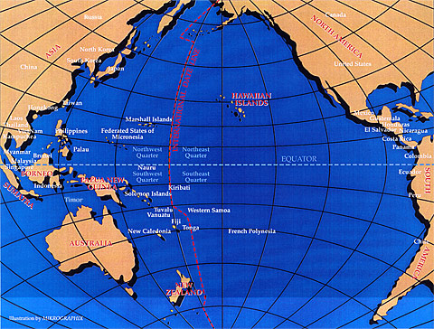
>> COLLABORATORIES: ISISTEM → fPARCSI
(federation of Pacific Rim Complex Systems Institutes)
Use ISISTEM as a base to organize needed new entities
Pacific Rim Complex Systems Institutes represent the hard sciences active in systems: (physics, math, cosmology, geology, biology, compsci)
Modeled after successes of NECSI and Sante Fe Institute
Significant potential increases in rigor & use of scientific literature
For both ISISTEM & fPARCSI main first order of business is attracting external funding; former IAS did attract $5.3 M before LRT retired
Both ISISTEM & fPARCSI would create many opportunities for the International Society for Systems Pathology, ISSP, and vice versa

Slide 24
CALL TO JOIN: YOU & NOW

Slide 25
Question/Follow-Up for ALL 3 Sessions on SPT/Systems Pathology?
For the last 15 min activity-discussion (please fill out your cards)
Did these presentations give you a good overall understanding of the proposed new specialty of top-down SysPath?
Do you see significant potential in SysPath for the field of Systems ENGINEERING?
Do you see clear relationships between natural systems and SysPath? And so between the INCOSE NSWG and SSWG’s?
What personal interest do you have in participating?
At which level?
In what ways?
Are these dreams too wild; impossible; unlikely
Give us your assessment
JOIN ISSP as a member, NOW
Become a FOUNDING member until Jan 2020; perpetual very low membership number

